Slide 1
Business analytics
Session 4

Slide 2
This week
Artificial Intelligence
Prescriptive Analytics
Predictive Analytics
Optimization (II, III)
Risk modeling (IV, V)
Value
Diagnostic Analytics
Forecasting (I)
Simulation (V, VI)
Descriptive Analytics
Extract, Transform, Load
Difficulty

Slide 3
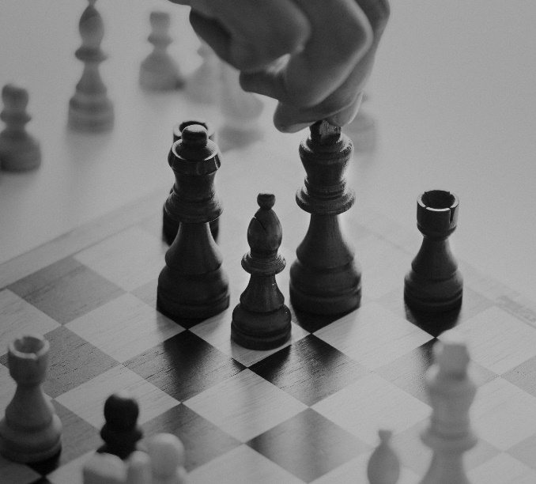
Game plan
MIDTERM FEEDBACK
ILP aDVANCED
Intro to RISK MODELING
RISK MODELING practice problems

Slide 4
Game plan
MIDTERM FEEDBACK
ILP aDVANCED (Week 3 leftover)
Intro to RISK MODELING
RISK MODELING practice problems

Slide 5
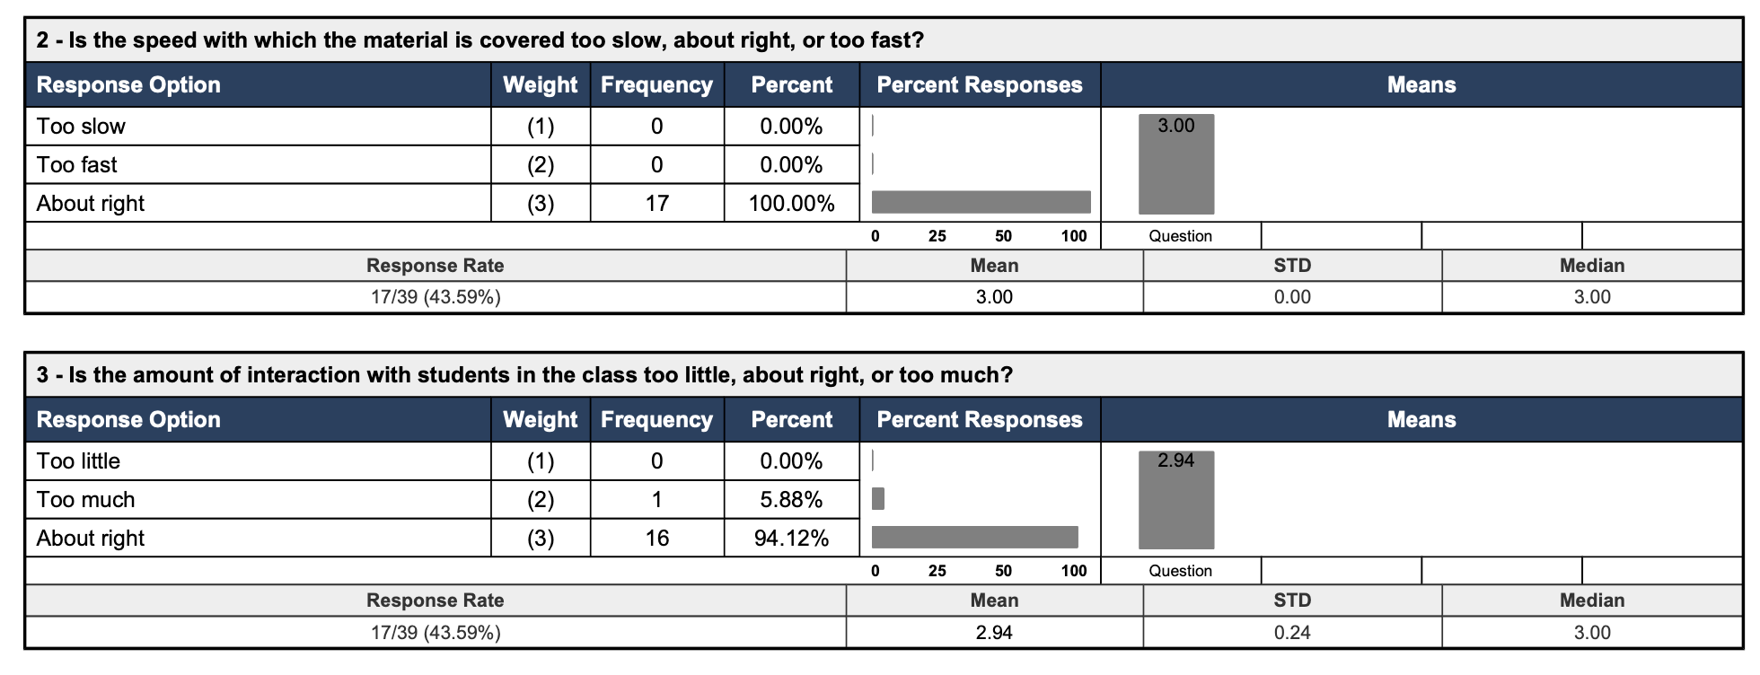
Midterm Feedback (T1)

Slide 6
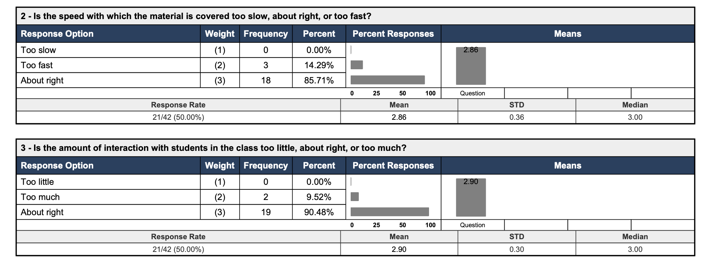
Midterm Feedback (T2)

Slide 7
Game plan
MIDTERM FEEDBACK
ILP aDVANCED
Intro to RISK MODELING
RISK MODELING practice problems

Slide 8

LOGICAL RELATIONSHIPS
Suppose we have five projects and we define binary variables Y1, .., Y5:
Y1 = 0 means project project 1 is not selected.
Y1 = 1 means project project 1 is selected.
Suppose project 2 & project 5 are international projects.
We will examine the following logical relationships:
at least m projects must be selected
at most n projects must be selected
exactly k projects must be selected
some projects are mutually exclusive
some projects have contingency relationships

Slide 9

BREAKOUT ROOMS (10 minutes)
Formulate constraints corresponding to each problem on the following slides

Slide 10
LOGICAL CONSTRAINTS
1. Select at least 1 international project, i.e. Select project 2 or project 5, or both.
Y2 + Y5 ≥ 1
If only project 2 is selected (Y2 = 1) or if only project 5 is selected (Y5 = 1), or if both are selected, the constraint is satisfied.
When both are not selected, Y2+Y5 = 0 and the constraint is not satisfied.
2. Select at most one domestic project.
Y1 + Y3 + Y4 ≤ 1
If 0 or 1 projects are selected, the constraint is satisfied.
If two are selected, Y1+Y3 +Y4 will be equal to 2 and the constraint is not satisfied. Same if you select all three.
3. Select exactly one domestic project.
Y1 + Y3 + Y4 = 1
If no domestic project is selected or 2 or 3 are selected, the constraint is not satisfied.

Slide 11
LOGICAL CONSTRAINTS
4. Projects 1 and 5 are mutually exclusive (require same resources)
Y1 + Y5 ≤ 1
If only project 1 is selected or if only project 5 is selected, or if both are not selected, the constraint is satisfied.
When both are selected, Y1+Y5 = 2 and the constraint is not satisfied.
5. If project 5 is selected, then project 4 must be as well.
Y4 - Y5 ≥ 0
If project 5 is selected, Y5 = 1 then Y4 must also be 1. If Y5=0, Y4 can be 0 or 1.
If Y5 =1 and Y4 = 0, the constraint is not satisfied.
6. All three domestic projects cannot be selected plus if project 1 is selected then project 2 must also be selected.
Y1 + Y3 + Y4 ≤ 2, Y2 – Y1 ≥ 0

Slide 12
Game plan
MIDTERM FEEDBACK
ILP aDVANCED
Intro to RISK MODELING
RISK MODELING practice problems

Slide 13

Modeling Risk and Uncertainty
Can you quantify risks/probabilities?
No
Use decision rules
No
Is the system “messy”?
(e.g. many, interacting sources of randomness)
Use decision trees and/or expected value analysis
Yes
Yes
Use simulation modeling (next week)

Slide 14

Key Risk Modeling Terms
Decision Alternatives: Different choices the decision maker can make
States of the world: Future events, not under control of decision maker, which may occur.
States of the world should be defined so that they are mutually exclusive and collectively exhaustive (MECE)
Outcomes: For each decision alternative and state of the world, there is a resulting outcome ($$$, lives saved, QALY etc.)
Decision Criterion: How decision maker chooses among the alternatives.

Slide 15


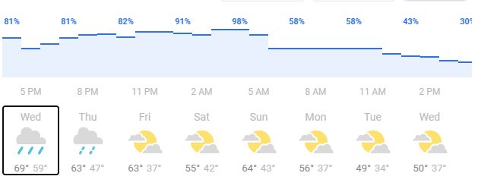
States of the world
States of the worlds (sometimes also called states of nature) are “events” that can occur and that influence the outcomes relevant for decision-maker. For example, tomorrow it can be:
States of the world are independent of our actions and cannot be controlled. But, we can often say something about the states of the world using probability distributions.
rainy
sunny

Slide 16
Example 1: Decision Tree
Suppose it rains with probability 50%.
Taking the umbrella has a “cost” of 10
Getting soaked has a “cost” of 50.
50%
50%
rain
sunny
Payoff Table
Decision: take umbrella? | State: Rain | State: Sun
Yes | -10 | -10
No | -50 | 0

Slide 17
Risk modeling: decision Trees
Decision Tree: A chronological representation of the decision problem consisting of three types of nodes:
Decision Node: Branches leaving decision node represent different decision alternatives.
State Node: Branches leaving state node represent different states.
Payoff Node: Payoffs attained if you arrive at that node.
Alternative 1
Decision Node:
Alternative 2
Alternative 3
State 1
State Node:
State 2
State 3
Payoff Node:
Payoff from Outcome

Slide 18
Example 1: Decision Tree
Payoff Nodes
E[V] = 0.5*(-10) + 0.5*(-10) = -10
Rain (0.5)
-10
YES
State Nodes:
weather
Sun (0.5)
-10
Decision Node:
Take an umbrella?
max(-10,-25)
-10
Rain (0.5)
NO
-50
E[V] = 0.5*-50 + 0.5*0 = -25
Sun (0.5)
0

Slide 19

Example 2: Compound events/ conditional probabilities
It rains with prob. 50%. Rain can be ”mild” or “heavy”, with equal chance.
Soaked under mild rain has a cost of 20
Soaked under heavy rain has a cost of 100
50% (conditional on rain)
50% (conditional on rain)
Heavy
Mild
Payoff Table
Decision: take umbrella? | State: Mild Rain | State: Heavy Rain | State: Sun
Yes | -10 | -10 | -10
No | -20 | -100 | 0

Slide 20
Example 2: Compound events/ conditional probabilities
Heavy (0.5)
-10
E[V] = 0.5*0.5*(-10)+ 0.5*0.5*(-10)
+ 0.5*(-10) = -10
Rain (0.5)
YES
Mild (0.5)
-10
State Nodes:
weather
Sun (0.5)
-10
Decision Node:
Take an umbrella?
max(-10,-30)
-10
Heavy (0.5)
-100
Rain (0.5)
NO
Mild (0.5)
-20
Sun (0.5)
E[V] = 0.5*0.5*(-100)+ 0.5*0.5*(-20)
+ 0.5*(0) = -30
0

Slide 21

Compound decision trees
If it is sunny you have the option to go to the beach, If you go to the beach, add 50 to your payoff
Partial payoff table (if it is sunny)
Decision: go to the beach? | State: Sunny, took umbrella | State: Sunny, no umbrella
Yes | 40 | 50
No | -10 | 0

Slide 22
Multiple Decisions
E[V] = 0.5*(-10) + 0.5*(40) = 15
Rain (0.5)
-10
YES
yes
40
State Nodes:
weather
Sun (0.5)
Max(40,-10)=40
no
-10
Decision Node:
Go to the beach?
Decision Node:
Take an umbrella?
max(15,0)
15
Rain (0.5)
NO
-50
yes
50
E[V] = 0.5*-50 + 0.5*50 = 0
Sun (0.5)
Max(50,0)=50
no
Decision Node:
Go to the beach?
0

Slide 23
Software for Drawing Trees
Excel has several decision tree add-ins (most cost $$$)
“Precision tree” (part of DecisionTools Suite) not available on Mac
Various user-made add-ins, for example “TreePlan” https://github.com/ybian/treeplan
Silver Decisions (Free online platform) https://silverdecisions.pl/

Slide 24
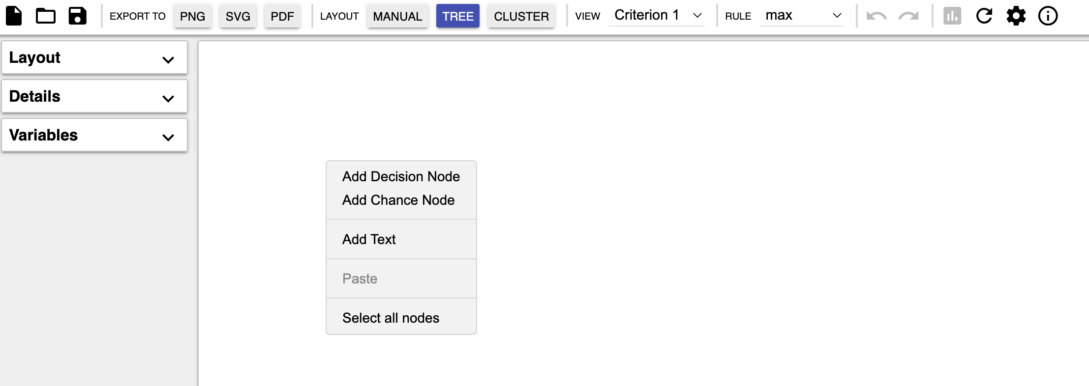
Drawing Trees in SilverDecisions
Double click anywhere to start the tree (we usually start with decision node)

Slide 25
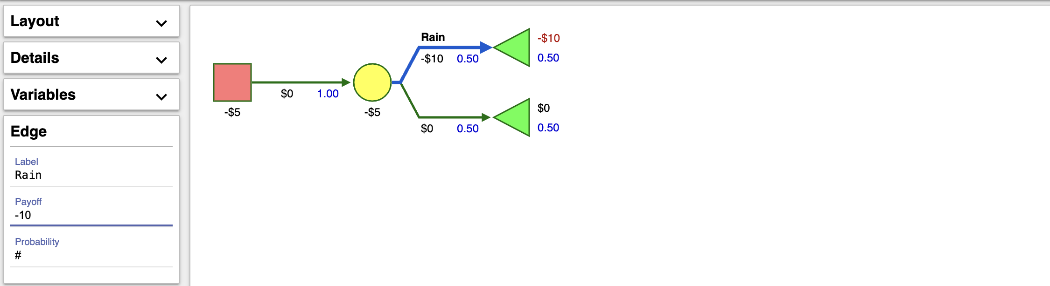
Drawing Trees in SilverDecisions
Describe event using label, payoff and probability
Tree will automatically calculate total payoffs at terminal nodes

Slide 26
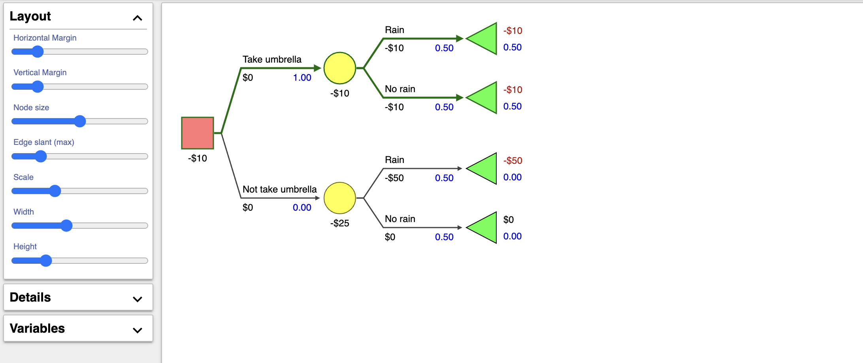
Drawing Trees in SilverDecisions
Automatically calculates expected payoff under optimal decisions
Automatically highlights optimal path in bold green
Change layout to improve visualization

Slide 27
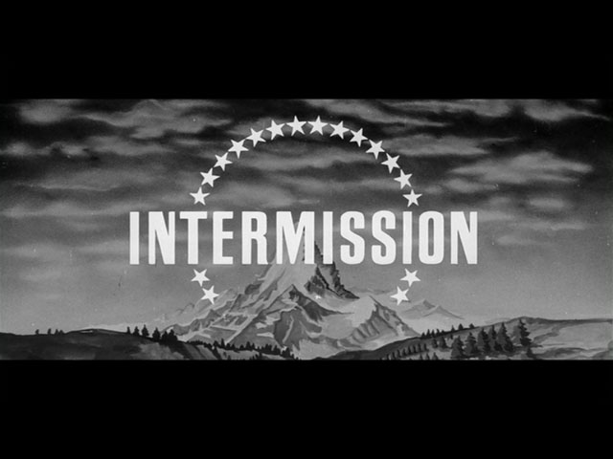

Slide 28
Game plan
MIDTERM FEEDBACK
ILP aDVANCED (Week 3 leftover)
Intro to RISK MODELING
RISK MODELING practice problems

Slide 29
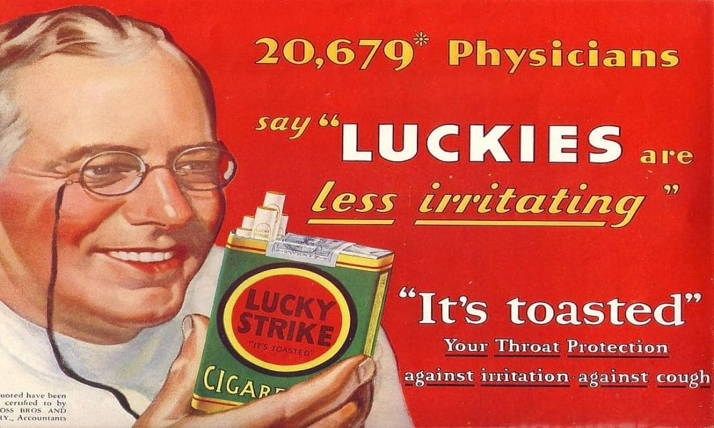

Slide 30
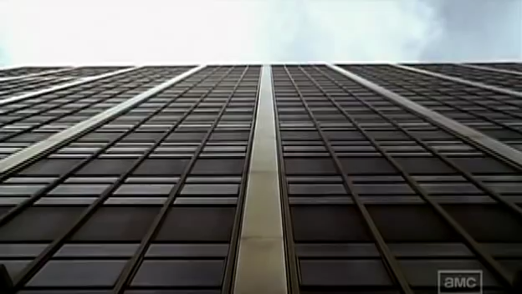
Notes:
https://www.dropbox.com/s/r7vij8z8cbt8ms8/madmen_trimmed.mp4?dl=0

Slide 31
GAP for Risk Modeling
Objective: depends on your decision criterion. Examples:
Maximize expected profit
Maximize worst-case scenario profit (MAXIMIN)
etc…
Random variables: defined by states of the world. Example: rain or sun tomorrow?
Decision variables: decision alternatives to choose from. Example: take umbrella (0/1)?
Constraints: usually no explicit constraints since only a few alternatives to choose from

Slide 32
Key Decision Analysis Terms: Lucky Strike
Advertising choice
No new ads
“It’s toasted”
“The world is dangerous”
Decision Alternatives

Slide 33
Key Decision Analysis Terms: Lucky Strike
States
Advertising choice | Good | Fair | Poor
No new ads | 100 | 60 | -10
“It’s toasted” | 200 | 50 | -40
“The world is dangerous” | 300 | 40 | -100
Decision Alternatives
Outcomes

Slide 34
Profit Payoff Decision Criteria
Criterion | Approach | Description
Maximax Profit | Most Optimistic | Pick alternative with highest highest profit
Maximin Profit | Most Conservative | Pick alternative with highest lowest profit
Minimax Regret | Most Averse to Regret | Pick alternative with lowest highest regret

Slide 35
Maximax Criterion: Lucky Strike
Maximax Criterion: Pick alternative with highest highest profit
Payoff Table
Ad type/ Response | Good | Fair | Poor
No new ads | 100 | 60 | -10
“It’s toasted” | 200 | 50 | -40
“The world is dangerous” | 300 | 40 | -100
Max
100
200
300
Highest

Slide 36
Maximin Criterion: Lucky Strike
Maximin Criterion: Pick alternative with highest lowest profit
Highest
Payoff Table
Ad type/ Response | Good | Fair | Poor
No new ads | 100 | 60 | -10
“It’s toasted” | 200 | 50 | -40
“The world is dangerous” | 300 | 40 | -100
Min
-10
-40
-100

Slide 37
Minimax Regret Criterion: Lucky Strike
Minimax Regret Criterion: Pick alternative with lowest possible regret
Payoff Table
Launch Strategy / Response | Good | Fair | Poor
No new ads | 100 | 60 | -10
“It’s toasted” | 200 | 50 | -40
“The world is dangerous” | 300 | 40 | -100
Regret under alternative X = best outcome in a given state –
outcome in that state under X
Regret Table
Launch Strategy / Response | Good | Fair | Poor
No new ads
“It’s toasted”
“The world is dangerous”
Max
200
0
0
200
Lowest Highest
(Min of Max) Regret
100
10
30
100
0
20
90
90

Slide 38
Decision Criteria & Expected Profit
Criterion | Outlook | Description
Maximax Profit | Most Optimistic | Pick alternative with highest highest profit
Maximin Profit | Most Conservative | Pick alternative with highest lowest profit
Minimax Regret | Most Averse to Regret | Pick alternative with lowest highest regret
Max Expected Profit | Risk Neutral | Pick alternative with highest expected profit

Slide 39
Max Expected Profit Criterion: Lucky Strike
Max Expected Profit Criterion: Pick alternative with highest expected profit
Payoff Table
Launch Strategy/ Response | Good | Fair | Poor
No new ads | 100 | 60 | -10
“It’s toasted” | 200 | 50 | -40
“The world is dang.” | 300 | 40 | -100
Expected Profit E[Profit]
(0.2)
(0.5)
(0.3)
0.2*100 + 0.5*60 + 0.3*(-10) = 47
0.2*200 + 0.5*50 + 0.3*(-40) = 53
0.2*300 + 0.5*40 + 0.3*(-100) = 50

Slide 40
Decision Tree: Lucky Strike
Payoff Nodes: Profit
E[V] = 0.2*100 + 0.5*60 + 0.3*(-10) = 47
Good (0.2)
100
No new ads
Fair (0.5)
60
State Nodes:
Market Response
Poor (0.3)
-10
Good (0.2)
200
It’s toasted
Fair (0.5)
Decision Node:
Type of ad
50
53
E[V] = 0.2*200 + 0.5*50 + 0.3*(-40) = 53
Poor (0.3)
-40
Good (0.2)
The world is dang.
300
max(47, 53, 50)
Fair (0.5)
40
E[V] = 0.2*300 + 0.5*40 + 0.3*(-100) = 50
Poor (0.3)
-100

Slide 41
Payoff vs Cost
Criterion | Outlook | Description
Minimin Cost | Most Optimistic | Pick alternative with the lowest lowest cost
Minimax Cost | Most Conservative | Pick alternative with lowest highest cost
Minimax Regret | Most Averse to Regret | Pick alternative with lowest possible regret
Min Expected Cost | Risk Neutral | Pick alternative with lowest expected cost

Slide 42
BREAKOUT ROOMS (15 minutes)
Use decision trees to solve the practice problem on the following slides.

Slide 43
Practice Problem 1
Firm B is threatening to sue us (Firm A) for patent infringement.
Firm B is already in court with Firm C for a similar issue. The chances of Firm B or Firm C winning the suit are equal. If firm B loses, they will not sue us. If Firm B wins, there is an 80% probability they will sue us.
If firm B sues us, we have 3 options. We can contest the patent itself, contest the settlement amount, or settle.
If we contest patent, there is 30% chance we win and don’t have to pay, and 70% that we lose and have to pay $10M
If we contest settlement amount, there is 40% chance we can get a low settlement of $5M, and a high amount of $15M otherwise
If we settle, it would cost us $8M
If instead of waiting we settle now, what should be the settlement amount?

Slide 44
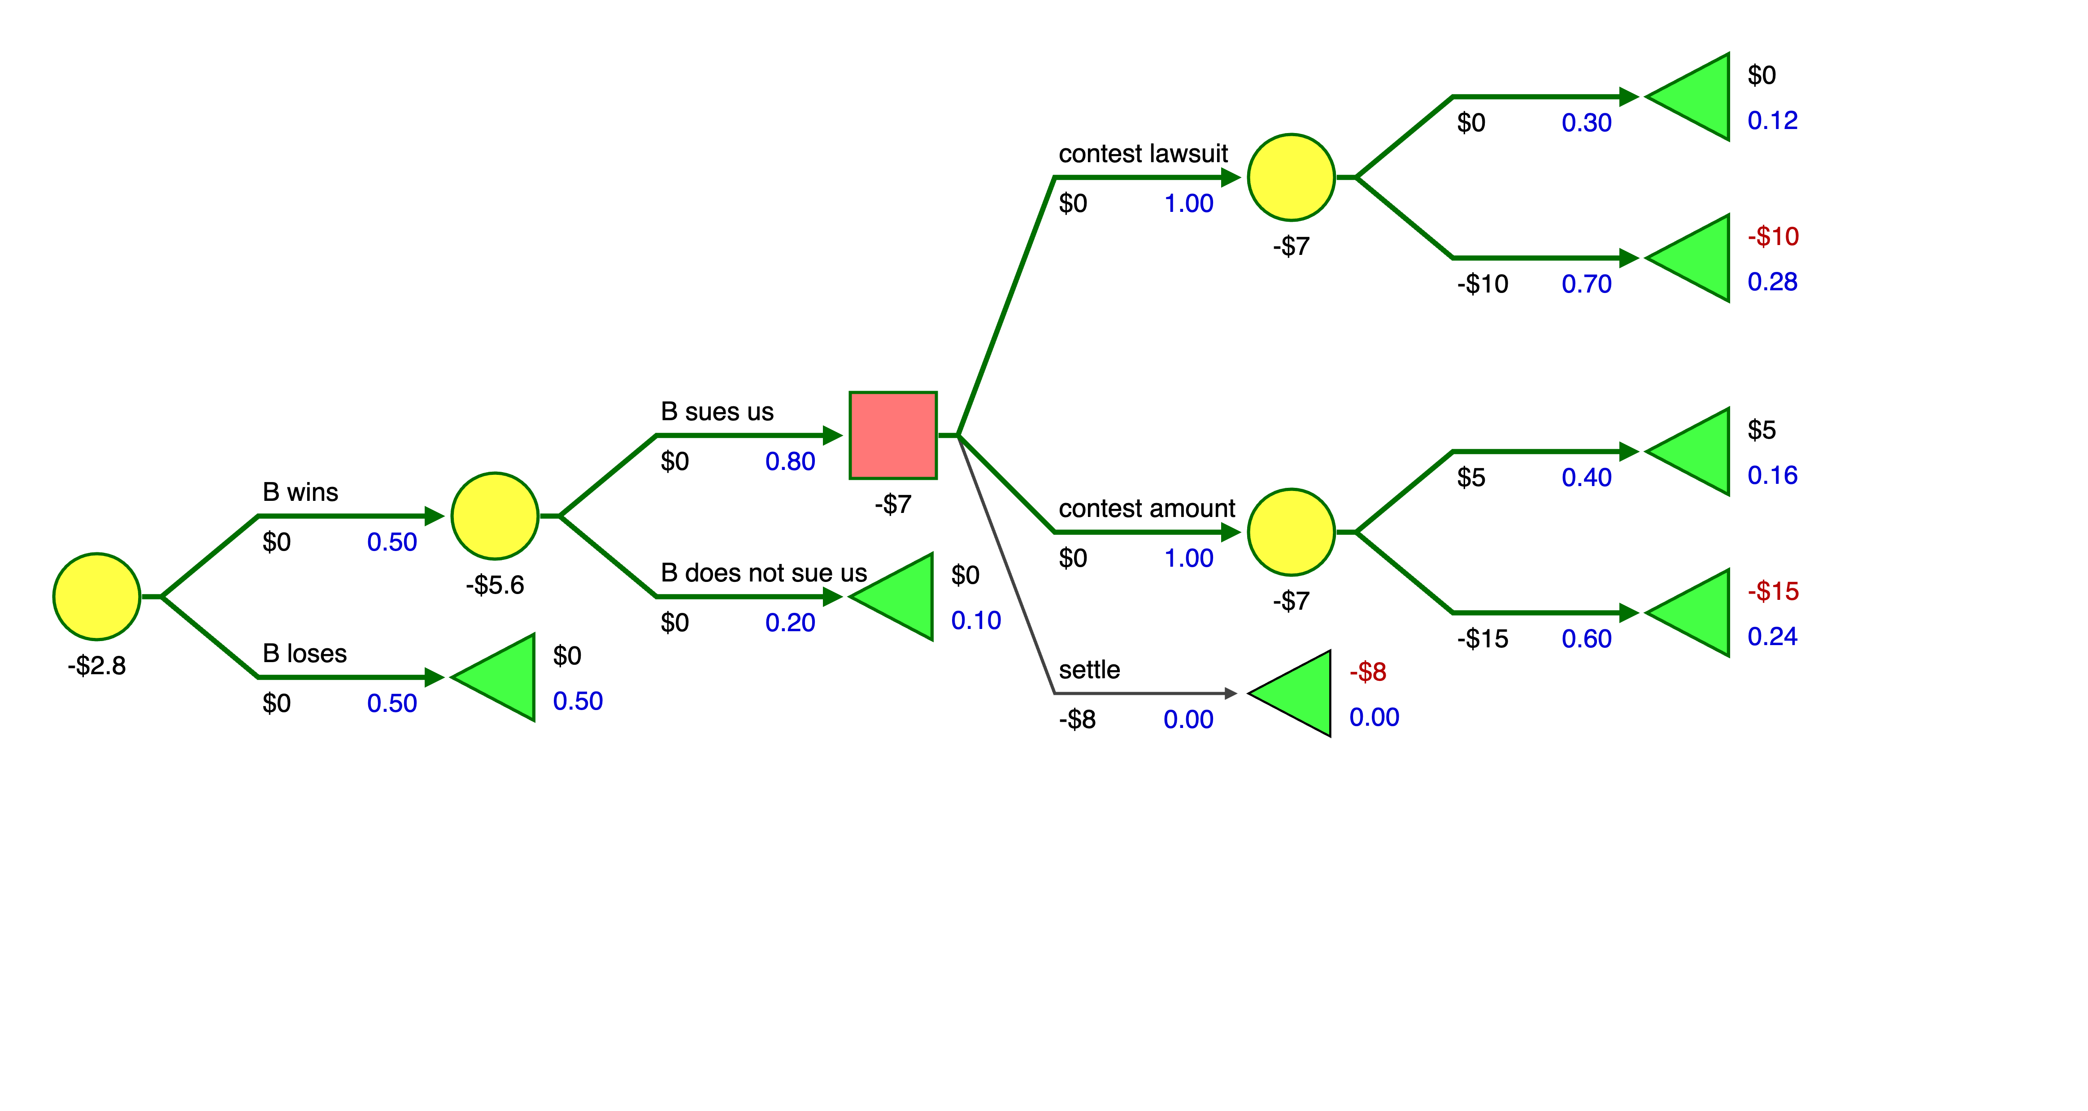
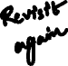
Practice Problem Solution
Answer: We would be willing to settle for up to 2.8 Million right now

Slide 45

Practice Problem 2: Healthcare and Risk Modeling
Company X is implementing a new policy for vaccinating its employees against a novel infectious disease.
Under this policy all employees who do not have immunity (through past vaccination or past infection) must be vaccinated once a year. Specifically, each year, the company must choose one of two types of single-shot vaccines. The cost of type A vaccine is 100 dollars per year per person and the cost of the type B vaccine is 200 dollars per year per person.
For each employee, the probability that the vaccination is successful (i.e. that the vaccinated employee develops immunity) in a given year is 50% under the type A vaccine and 80% under the type B vaccine. A successful vaccination results in lifelong immunity.
If vaccination fails, the risk of contracting the disease is 20% in that year. Each infection results in lifelong immunity (100% survival rate). The infection is not lethal, but it requires a treatment that costs $1000.

Slide 46
Practice Problem 2: Healthcare and Risk Modeling
Suppose you are a health insurance company paying for all medical expenses of Company X. You want to minimize total costs. Use a decision tree to represent and solve the problem of determining the minimum expected cost vaccination plan for an employee with a one-year contract.
What is the minimum expected cost vaccination plan for an employee with a two-year contract?
If there are 100 employees with a one-year contract and 100 employees with a two-year contract, what is the minimum expected total cost of vaccinating all 200 employees?
Suppose now that you are Company X. If you are now told by the insurance company that you may use up to 102% of the cost computed in part c) what will be your recommendation? Your answer should include justification for the objective function it would optimize.

Slide 47
Healthcare and Risk Modeling: Answer a)
Success (0.5)
E[C] = 0.5*100 + 0.5*0.2*1100 + 0.5*0.8*100 = 200
E[C] = 100
Contracted infection?
E[C] = 100
Vaccine A
No (0.8)
Fail (0.5)
E[C] = min (200,240)=200 → Answer: A
Yes (0.2)
E[C] = 100 + 1000
Success (0.8)
E[C] = 200
Contracted infection?
E[C] = 200
Vaccine B
No (0.8)
Fail (0.2)
E[C] = 0.8*200 + 0.2*0.2*1200 + 0.2*0.8*200 = 240
Yes (0.2)
E[C] = 200 + 1000

Slide 48

Healthcare and Risk Modeling: Answer b)
Success (0.5)
E[TC] = 100*0.5 + 1100*0.2* 0.5
+ 300*0.8* 0.5 = 280
E[TC] = 100
A
E[TC] = 300 (See part a)
E[TC] = min (300, 340) = 300
Contracted infection?
No (0.8)
B
Vaccine A
E[TC] = 340 (See part a)
Fail (0.5)
Yes (0.2)
E[TC] = min (280,272)=272 → Answer: year 1: B, Year 2: A
E[TC] = 1100
Success (0.8)
E[TC] = 200
A
Vaccine B
E[TC] = 400 (See part a)
E[TC] =min (400,440) = 400
Contracted infection?
B
No (0.8)
E[TC] = 200*0.8 + 1200 *0.2 * 0.2 + 400 *0.2 * 0.8 = 272
Fail (0.2)
E[TC] = 440 (See part a)
Yes (0.2)
E[TC] = 1200

Slide 49
Healthcare and Risk Modeling: Answer c), d)
If there are 100 employees with a one-year contract and 100 employees with a two-year contract, what is the minimum expected total cost of vaccinating all 200 employees?
100*$200 + 100*$272 = $47200
If you are now told that you may use up to 102% of the cost you computed in part c) what will be your recommendation? How would that affect the number of people vaccinated with vaccine A vs B? Your answer should include justification for the objective function it would optimize.
The objective function becomes to reduce number of infections as fast as possible (first in year 1, then in year 2). Cost (budget) becomes a constraint.
We are already vaccinating everyone with the more effective vaccine in year 1. Hence, the change will affect only year 2. We can calculate how many more infections can be prevented compared to scenario in c):
$47200 * 0.02 = $944 → can vaccinate $944/40=23.6 additional people in year 2 with vaccine B reducing infections by 23.6*(0.8-0.5)*0.2 = 1.4 people compared to c).

